Slide 1
PROPERTY
ANALYSIS
SQL Query Reference Guide
Presented by
Jimit Ghusar
25 structured SQL queries covering data exploration,
filtering, aggregation, window functions & CASE expressions.
Database: property · Table: property_analysis · MySQL 8.0

Slide 2
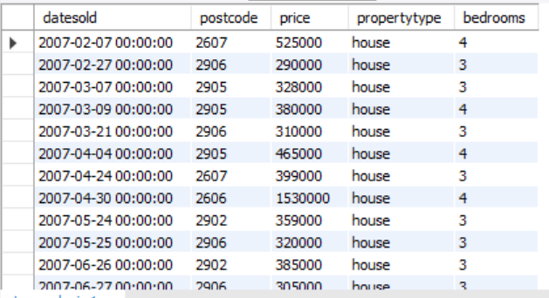
Database Setup & Table Structure
Creating the database, table schema and loading CSV data
📋 Purpose
Sets up the MySQL environment: creates the database, defines the table schema with 5 columns, and loads property data from a CSV file using LOAD DATA INFILE.
SQL
create database property; use property;
create table property_analysis(
datesold varchar(50), postcode int, price int,
propertytype varchar(10), bedrooms int
);
LOAD DATA INFILE 'C:/.../Property_analysis.csv'
INTO TABLE property_analysis CHARACTER SET LATIN1
FIELDS TERMINATED BY ',' ENCLOSED BY '"' IGNORE 1 ROWS;
💡 LOAD DATA INFILE is MySQL's fast bulk-import command — much faster than INSERT for large CSV datasets.

Slide 3
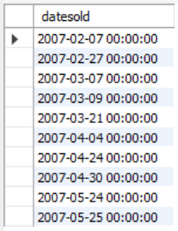
Q1
Display First 10 Sale Dates
Previewing date entries with LIMIT
📋 Purpose
Retrieves only the datesold column for the first 10 rows. Useful for quickly checking the date format stored in the table before applying date functions.
SQL
SELECT datesold
FROM property_analysis
LIMIT 10;
💡 LIMIT is essential for quick previews — always use it when exploring large tables to avoid fetching millions of rows.

Slide 4
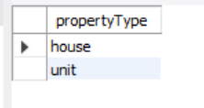
Q2
Show Distinct Property Types
Finding unique values with DISTINCT
📋 Purpose
Returns the unique property types available in the dataset (e.g., 'house', 'unit'). Helps understand what categories exist before writing type-based filters.
SQL
SELECT DISTINCT propertyType
FROM property_analysis;
💡 DISTINCT removes duplicate values — equivalent to GROUP BY without aggregation. Great for data profiling.

Slide 5
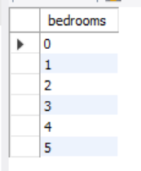
Q3
Show Distinct Bedroom Counts
Listing all unique bedroom values in sorted order
📋 Purpose
Retrieves every unique bedroom count value, ordered numerically. This reveals the full range of bedroom configurations available in the dataset (e.g., 1, 2, 3, 4, 5+).
SQL
SELECT DISTINCT bedrooms
FROM property_analysis
ORDER BY bedrooms;
💡 Pairing DISTINCT with ORDER BY gives a clean sorted list — perfect for understanding the spread of a numeric category column.

Slide 6
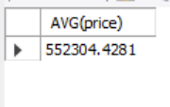
Q4
Average Price of 3-Bedroom Properties
Using AVG() with a WHERE filter
📋 Purpose
Calculates the mean sale price specifically for properties with 3 bedrooms. This benchmark is valuable for pricing analysis and comparing against other bedroom configurations.
SQL
-- Average price for 3-bedroom properties
SELECT AVG(price)
FROM property_analysis
WHERE bedrooms = 3;
💡 AVG() automatically ignores NULL values. Always pair with COUNT(*) to know how many records contributed to the result.

Slide 7
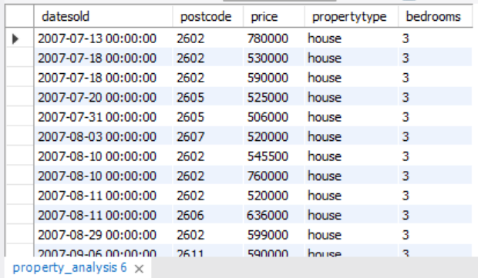
Q5
Houses with 3 Bedrooms Priced Over $500K
Combining multiple WHERE conditions with AND
📋 Purpose
Filters records matching three simultaneous conditions: property type is 'house', price exceeds $500,000, and bedroom count is exactly 3. This targets a specific premium market segment.
SQL
SELECT * FROM property_analysis
WHERE propertyType = 'house'
AND price > 500000
AND bedrooms = 3;
💡 Each AND condition narrows the result further. The order of conditions doesn't affect results — MySQL optimizes the execution plan automatically.

Slide 8
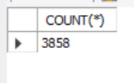
Q6
Year-Wise Data Filtering
Using YEAR() function to extract year from date column
📋 Purpose
Since datesold is stored as a date/varchar, YEAR() extracts the year component for comparison. These queries isolate records from a specific year or count entries for trend analysis.
SQL
-- All records from 2015
SELECT * FROM property_analysis WHERE YEAR(datesold) = 2015;
-- Count of sales in 2018
SELECT COUNT(*) FROM property_analysis WHERE YEAR(datesold) = 2018;
-- All records after 2016
SELECT * FROM property_analysis WHERE YEAR(datesold) > 2016;
💡 YEAR() is a date function that works on DATE and DATETIME types. For text dates, ensure proper format or use STR_TO_DATE() first.

Slide 9
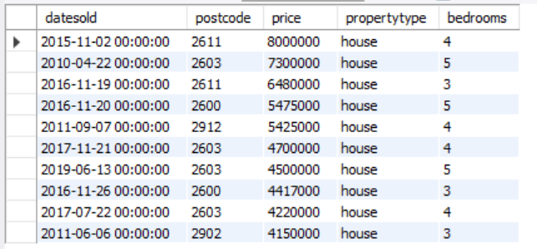
Q7
Top 10 Most Expensive Houses
Ranking with ORDER BY DESC + LIMIT
📋 Purpose
Retrieves the 10 highest-priced house listings by sorting descending on price and limiting output. This is the classic SQL 'Top N' pattern used in leaderboards and market analysis.
SQL
SELECT * FROM property_analysis
WHERE propertyType = 'house'
ORDER BY price DESC
LIMIT 10;
💡 Always include ORDER BY before LIMIT — without it, SQL returns an arbitrary 10 rows, not the top 10.

Slide 10
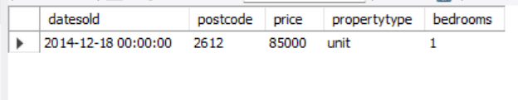
Q8
Cheapest Unit Property
Finding the minimum-priced record with ASC + LIMIT 1
📋 Purpose
Finds the single least expensive unit property by sorting price in ascending order and returning only the first row. Useful for identifying the market floor for a specific property type.
SQL
SELECT * FROM property_analysis
WHERE propertyType = 'unit'
ORDER BY price ASC
LIMIT 1;
💡 LIMIT 1 with ORDER BY ASC is equivalent to MIN() but returns the full row — not just the price value.

Slide 11
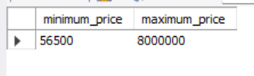
Q9
Minimum & Maximum Property Price (Overall)
Using MIN() and MAX() aggregate functions
📋 Purpose
Returns the lowest and highest sale prices across the entire dataset in a single query. Essential for understanding the full price range before segmenting or filtering data.
SQL
SELECT
MIN(price) AS minimum_price,
MAX(price) AS maximum_price
FROM property_analysis;
💡 Aliasing columns with AS makes output self-documenting — especially important when results are exported to reports or dashboards.

Slide 12
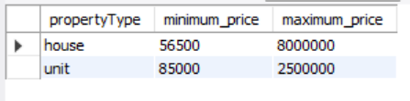
Q10
Min & Max Price by Property Type
GROUP BY with MIN() and MAX() per category
📋 Purpose
Groups the dataset by property type and calculates the price floor and ceiling for each category separately. Enables side-by-side comparison of price ranges across houses and units.
SQL
SELECT
propertyType,
MIN(price) AS minimum_price,
MAX(price) AS maximum_price
FROM property_analysis
GROUP BY propertyType;
💡 Every non-aggregated column in SELECT must appear in GROUP BY — a fundamental SQL rule that prevents ambiguous grouping.

Slide 13
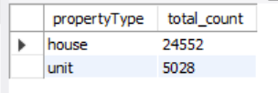
Q11
Count of Sales by Property Type
GROUP BY with COUNT(*) for volume analysis
📋 Purpose
Counts how many properties of each type were sold. This query answers 'which property type is more common in the market?' — a key metric for supply/demand analysis.
SQL
SELECT propertyType, COUNT(*) AS total_count
FROM property_analysis
GROUP BY propertyType;
💡 COUNT(*) counts all rows including NULLs, while COUNT(column) skips NULLs. Use COUNT(*) when counting records, not values.

Slide 14
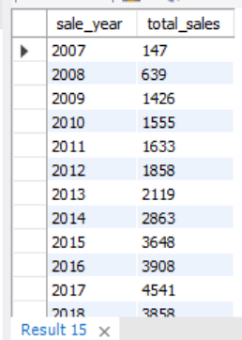
Q12
Count Total Sales Year-Wise
Tracking sales volume trends over time
📋 Purpose
Groups records by year and counts sales in each year. This reveals how market activity has changed over time — identifying boom years, slowdowns, or consistent growth patterns.
SQL
SELECT
YEAR(datesold) AS sale_year,
COUNT(*) AS total_sales
FROM property_analysis
GROUP BY sale_year
ORDER BY sale_year;
💡 ORDER BY sale_year ensures years appear in chronological order — without it, grouping output order is undefined in SQL.

Slide 15
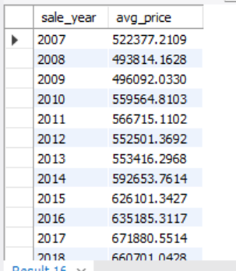
Q13
Average Price Year-Wise
Tracking price appreciation trends over years
📋 Purpose
Calculates the average sale price grouped by year. This is one of the most important metrics in property analysis — revealing whether prices are rising, falling, or staying flat over time.
SQL
SELECT
YEAR(datesold) AS sale_year,
AVG(price) AS avg_price
FROM property_analysis
GROUP BY sale_year
ORDER BY sale_year;
💡 Combining this with the year-wise count (Q12) gives a richer picture — rising prices with falling volume signals a seller's market.

Slide 16

Q14
Most Popular Bedroom Configuration
Finding top-selling bedroom count with ORDER BY + LIMIT 1
📋 Purpose
Identifies which bedroom count has the highest number of sales. This reveals the most in-demand property size — critical for developers, investors and agents targeting high-demand segments.
SQL
SELECT
bedrooms,
COUNT(*) AS total_sales
FROM property_analysis
GROUP BY bedrooms
ORDER BY total_sales DESC
LIMIT 1;
💡 Remove LIMIT 1 to see the full ranked list of all bedroom counts — useful for understanding the complete demand spectrum.

Slide 17
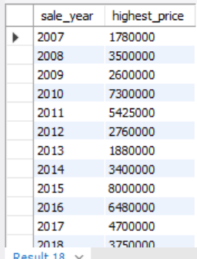
Q15
Highest Property Price Year-Wise
Tracking annual price peaks with MAX()
📋 Purpose
Finds the single highest property price recorded in each year. This highlights premium market activity and reveals whether the top end of the market is growing or contracting over time.
SQL
SELECT
YEAR(datesold) AS sale_year,
MAX(price) AS highest_price
FROM property_analysis
GROUP BY sale_year
ORDER BY sale_year;
💡 Comparing MAX() trends vs AVG() trends reveals whether price growth is broad-based or driven only by outlier luxury sales.

Slide 18
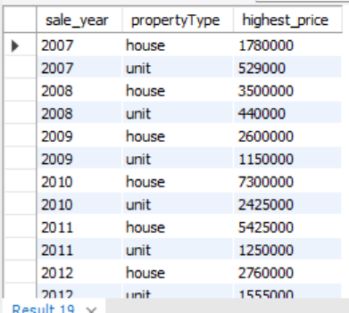
Q16
Highest Price Per Year × Property Type
Multi-column GROUP BY for cross-dimensional analysis
📋 Purpose
Groups simultaneously by year AND property type, returning the peak price for each combination. This 2D breakdown reveals whether houses or units are driving premium price growth each year.
SQL
SELECT
YEAR(datesold) AS sale_year,
propertyType,
MAX(price) AS highest_price
FROM property_analysis
GROUP BY sale_year, propertyType
ORDER BY sale_year, propertyType;
💡 Multi-column GROUP BY creates a matrix-like output — great for comparing trends across two dimensions simultaneously.

Slide 19
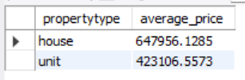
Q17
Average Price for Each Property Type
Simple GROUP BY aggregation for market benchmarks
📋 Purpose
Calculates the mean sale price for houses and units separately. This benchmark reveals the price premium between property types and is fundamental to any comparative market analysis.
SQL
SELECT
propertytype,
AVG(price) AS average_price
FROM property_analysis
GROUP BY propertytype;
💡 Use ROUND(AVG(price), 2) to format the output to 2 decimal places — makes large numbers more readable in reports.

Slide 20
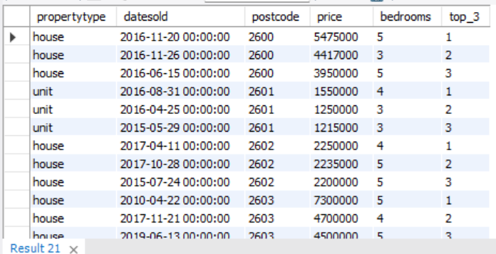
Q18
Top 3 Most Expensive Properties Per Postcode
Window function ROW_NUMBER() with PARTITION BY postcode
📋 Purpose
Uses a subquery with ROW_NUMBER() partitioned by postcode to rank properties within each postcode zone by price. The outer query then filters only the top 3 from each zone.
SQL
SELECT * FROM
(SELECT propertytype, datesold, postcode, price, bedrooms,
ROW_NUMBER() OVER
(PARTITION BY postcode ORDER BY price DESC) AS top_3
FROM property_analysis) AS ranked
WHERE top_3 <= 3;
💡 PARTITION BY resets the row counter for each postcode — this is the key difference between ROW_NUMBER() with and without partitioning.

Slide 21
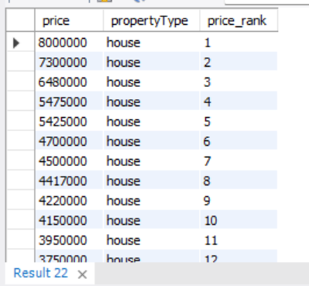
Q19
Rank Properties by Price (Global)
ROW_NUMBER() OVER ORDER BY for global price ranking
📋 Purpose
Assigns a sequential rank to every property based on price (highest = rank 1) across the entire dataset. This provides a global leaderboard of all properties by sale value.
SQL
SELECT
price,
propertyType,
ROW_NUMBER() OVER (ORDER BY price DESC) AS price_rank
FROM property_analysis;
💡 ROW_NUMBER() always assigns unique ranks — no ties. Use RANK() if you want tied records to share the same rank number.

Slide 22
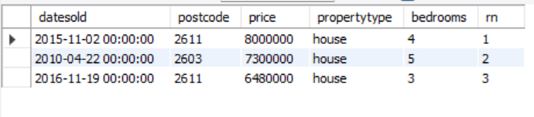
Q20
Top 3 Highest Priced Houses
ROW_NUMBER() with PARTITION BY type filtered to houses
📋 Purpose
Partitions the dataset by property type, ranks by price within each partition, then filters to only return the top 3 house records. Isolates the most premium house sales from the full dataset.
SQL
SELECT * FROM (
SELECT *,
ROW_NUMBER() OVER
(PARTITION BY propertyType ORDER BY price DESC) AS rn
FROM property_analysis
) t
WHERE propertyType = 'house'
AND rn <= 3;
💡 Window functions cannot be used in WHERE directly — always wrap them in a subquery or CTE to filter on the computed rank.

Slide 23
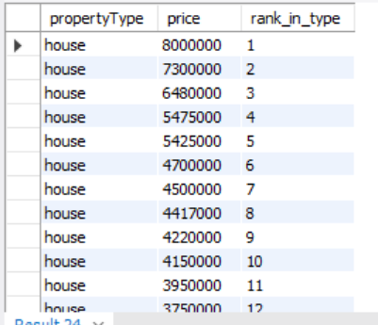
Q21
Rank Price Separately for House and Unit
Partitioned ranking for type-level price leaderboards
📋 Purpose
Creates separate price rankings for houses and units by using PARTITION BY propertyType. Each property type gets its own independent rank starting from 1 — enabling fair within-type comparison.
SQL
SELECT
propertyType,
price,
ROW_NUMBER() OVER (
PARTITION BY propertyType
ORDER BY price DESC
) AS rank_in_type
FROM property_analysis;
💡 PARTITION BY is the window function equivalent of GROUP BY — it defines the boundary within which the ranking resets.

Slide 24
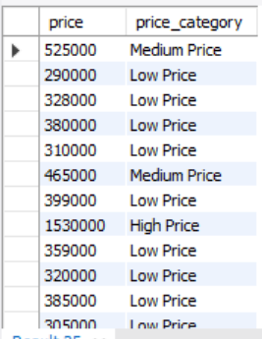
Q22
Categorize Properties Based on Price
CASE expression for custom price tier labels
📋 Purpose
Uses a CASE statement to assign a human-readable price category label to each property: Low (< $400K), Medium ($400K–$700K), or High (> $700K). Enables quick market-tier segmentation.
SQL
SELECT
price,
CASE
WHEN price < 400000 THEN 'Low Price'
WHEN price BETWEEN 400000 AND 700000 THEN 'Medium Price'
ELSE 'High Price'
END AS price_category
FROM property_analysis;
💡 CASE WHEN is evaluated top-down — the first matching condition wins. Always put the most restrictive condition first.

Slide 25
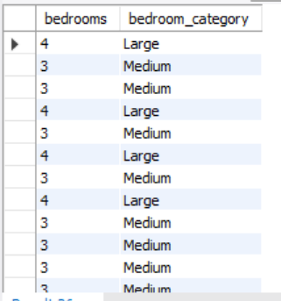
Q23
Categorize Bedroom Size
CASE expression for bedroom configuration labels
📋 Purpose
Maps raw bedroom counts to descriptive size labels: Small (≤ 2 beds), Medium (3 beds), Large (4+ beds). Simplifies bedroom data into business-friendly categories for reporting.
SQL
SELECT
bedrooms,
CASE
WHEN bedrooms <= 2 THEN 'Small'
WHEN bedrooms = 3 THEN 'Medium'
ELSE 'Large'
END AS bedroom_category
FROM property_analysis;
💡 CASE can be used in SELECT, WHERE, ORDER BY and GROUP BY — making it one of SQL's most versatile expressions.

Slide 26
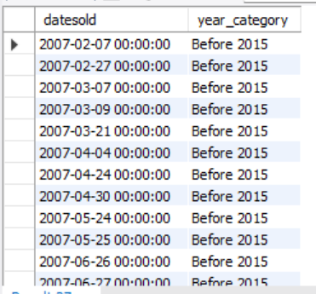
Q24
Classify Sales Year into Two Groups
CASE with YEAR() for historical period labeling
📋 Purpose
Labels every sale as either 'Before 2015' or 'After 2015' using a CASE expression on the year. This simplifies time-based segmentation for period-over-period comparison analysis.
SQL
SELECT
datesold,
CASE
WHEN YEAR(datesold) <= 2015
THEN 'Before 2015'
ELSE 'After 2015'
END AS year_category
FROM property_analysis;
💡 Combining CASE with GROUP BY on the alias enables aggregation by these custom periods — e.g., COUNT(*) GROUP BY year_category.

Slide 27
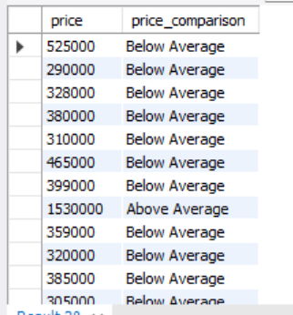
Q25
Compare Price with Overall Average
CASE with a correlated subquery for above/below average tagging
📋 Purpose
Tags each property as 'Above Average' or 'Below Average' by comparing its price to the dataset-wide average, computed inline via a subquery. Identifies premium vs value properties instantly.
SQL
SELECT
price,
CASE
WHEN price > (SELECT AVG(price) FROM property_analysis)
THEN 'Above Average'
ELSE 'Below Average'
END AS price_comparison
FROM property_analysis;
💡 The subquery (SELECT AVG(price)...) runs once and returns a scalar value reused for every row comparison — this is efficient and clean.

Slide 28
Query Summary
25 SQL queries across 6 key technique categories
🔍 Data Exploration
🎯 Filtering & Conditions
📊 Sorting & Ranking
Q1–Q3
Q4–Q6
Q7–Q8
DISTINCT · LIMIT · ORDER BY
WHERE · AND · YEAR() · AVG
ORDER BY DESC/ASC · LIMIT N
🔢 Aggregation
🪟 Window Functions
🔀 CASE Expressions
Q9–Q17
Q18–Q21
Q22–Q25
MIN · MAX · AVG · COUNT · GROUP BY
ROW_NUMBER · PARTITION BY · OVER
CASE WHEN · THEN · ELSE · Subquery
property_analysis database · MySQL 8.0 · raw_sales table

